Slide 1

Nexus Consulting
Kevin Anani, Lorenzo Bartolini, Jay Sethia, Ngoc-Quyen Vu, Ankit Yadav
BUDT758Y
Prof. Lee

Slide 2

Users and Source
Users – Current students, teachers, counselors, members of the University of Maryland education system
Data Source – Alumnus of the University of Maryland

Slide 3

Mission Statement
The client’s mission is to provide an informational database for the alumni of the University of Maryland. The database will have alumni contact information, prior education history, current job detail, work experience and company.

Slide 4

Mission Objective
Provide a contact database for the alumni of the University of Maryland.
Provide insight into University of Maryland alumni’s educational background.
Provide insight into which companies their alumni are working at, and in what capacity.

Slide 5
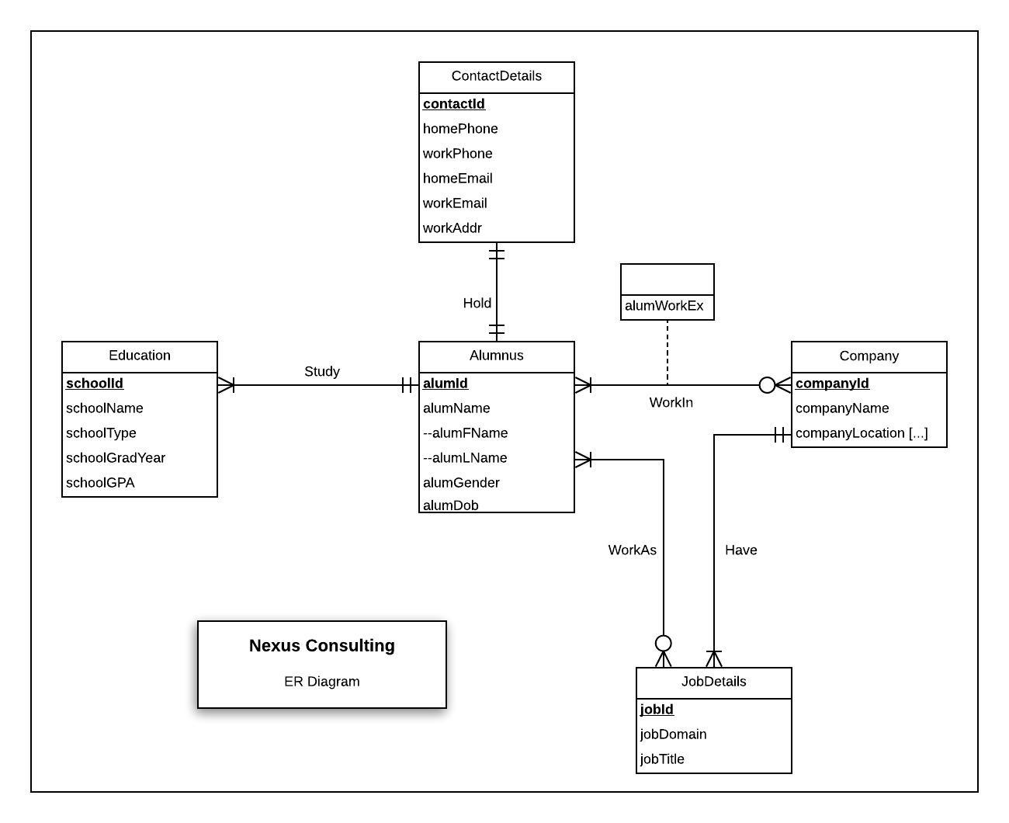
Conceptual Database Design

Slide 6

Relational Schema
Alumnus (alumId, alumFName, alumLName, alumGender, alumDob, contactId)
Education (schoolId, schoolName, schoolType, schoolGradYear, schoolGPA, alumId)
Company (companyId, companyName, companyLocation[…])
jobDetails (jobId, jobDomain, jobTitle, companyId)
contactDetails (contactId, homePhone, workPhone, homeEmail, workEmail, workAddr)
WorkIn (alumId, companyId, alumWorkEx)
WorkAs (alumId, jobId)

Slide 7

Functional Dependency
alumId→alumFName, alumLName, alumGender, alumDOB
companyId→companyName, companyLocation[…]
jobId→jobDomain, jobTitle
schoolId→schoolName,schoolType,schoolGradYear,schoolGPA
contactId→homePhone,workPhone,homeEmail,workEmail,workAddr
alumId, companyId→alumWorkEx

Slide 8

Normalization
alumnus (alumId, alumFName, alumLName, alumGender, alumDob, contactId)
education (schoolId, alumId, schoolName, schoolType, schoolGradYear, schoolGPA)
jobDetails (jobId, companyId, jobDomain, jobTitle)
company (companyId, companyName, companyLocation)
workIn (alumId, companyId, alumWorkEx)
contactDetails (contactId, homePhone, workPhone, homeEmail, workEmail, workAddr)
WorkAs (alumId, jobId)

Slide 9

Physical Database Design
CREATE TABLE Education (schoolId INTEGER NOT NULL, schoolName VARCHAR (25), schoolType VARCHAR (25), schoolGradYear DATE, schoolGPA FLOAT, alumId INTEGER, CONSTRAINT pk_Education_schoolId PRIMARY KEY (schoolId), CONSTRAINT fk_Education_alumId FOREIGN KEY (alumId) REFERENCES Alumnus (alumId) ON DELETE NO ACTION ON UPDATE CASCADE);

Slide 10
Use Case 1
What alumni are now working in Chicago?
SELECT a.*,c.* from Alumnus a JOIN WorkIn w ON a.alumId = w.alumId JOIN Company c ON c.companyId = w.companyId WHERE companyLocation = “Chicago” ORDER BY alumFName, alumLName;

Slide 11
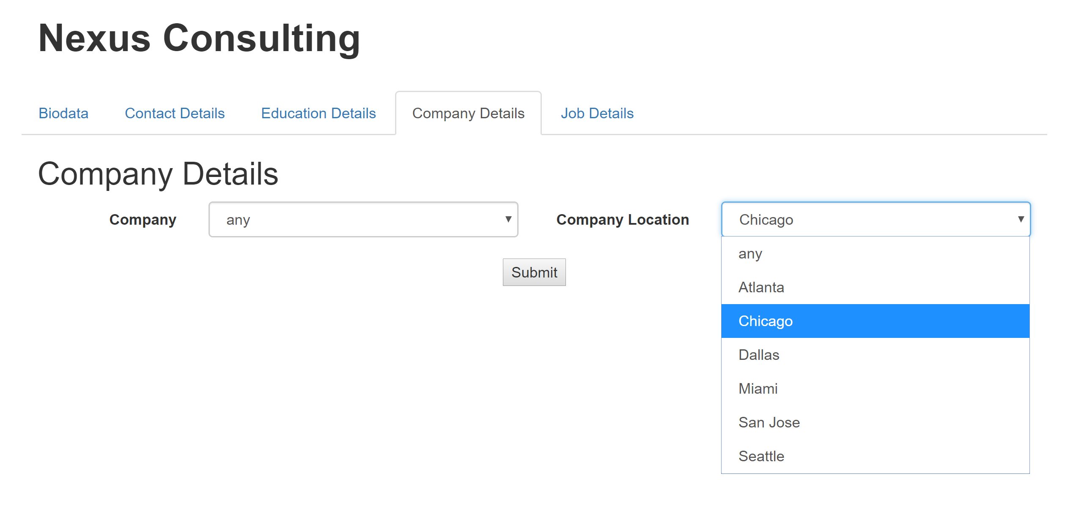
What alumni are now working in Chicago?

Slide 12
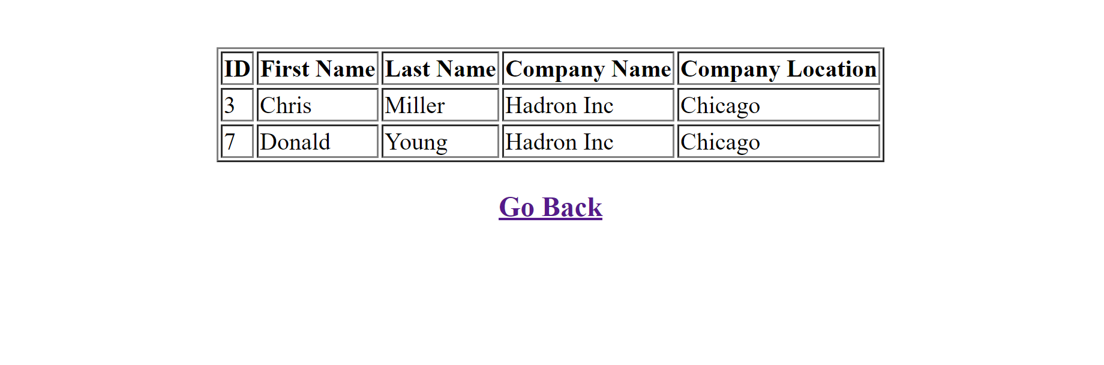
What alumni are now working in Chicago?
Our query joins the alumnus and the company table, to give us the result of which alumni are working in Chicago. We can see from the results that two of our alumni are working in a company called Hadron Inc which is located in Chicago, Illinois.

Slide 13
Use Case 2
What alumni graduated before 2014 with a CGPA of above 3.5?
SELECT * FROM Alumnus AS a JOIN Education e ON a.alumId = e.alumId WHERE schoolGPA >=3.5 AND schoolGradYear <‘2014-01-01’ ORDER BY a.alumFName, a.alumLName, a.alumId, e.schoolGradYear;

Slide 14
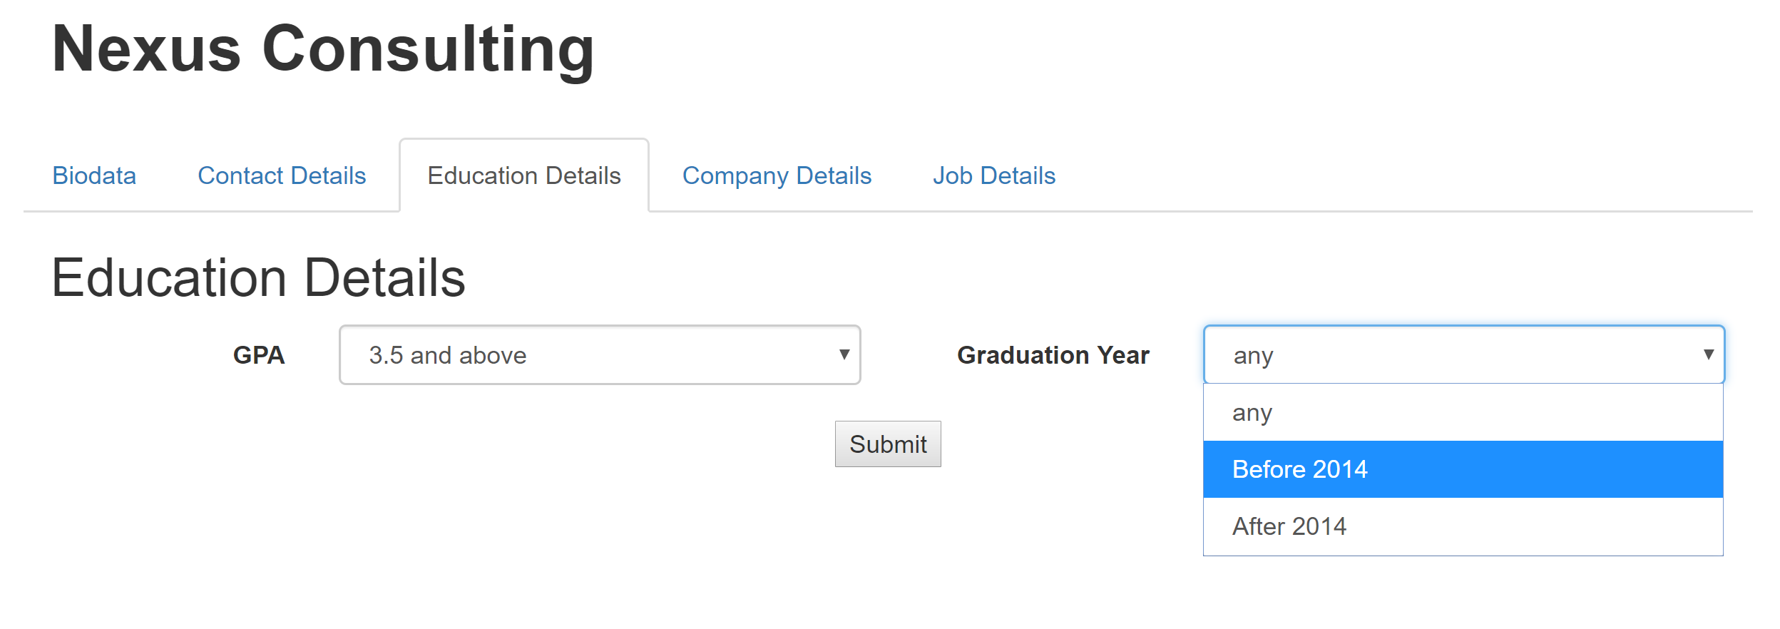
What alumni graduated before 2014 with a CGPA of above 3.5?

Slide 15
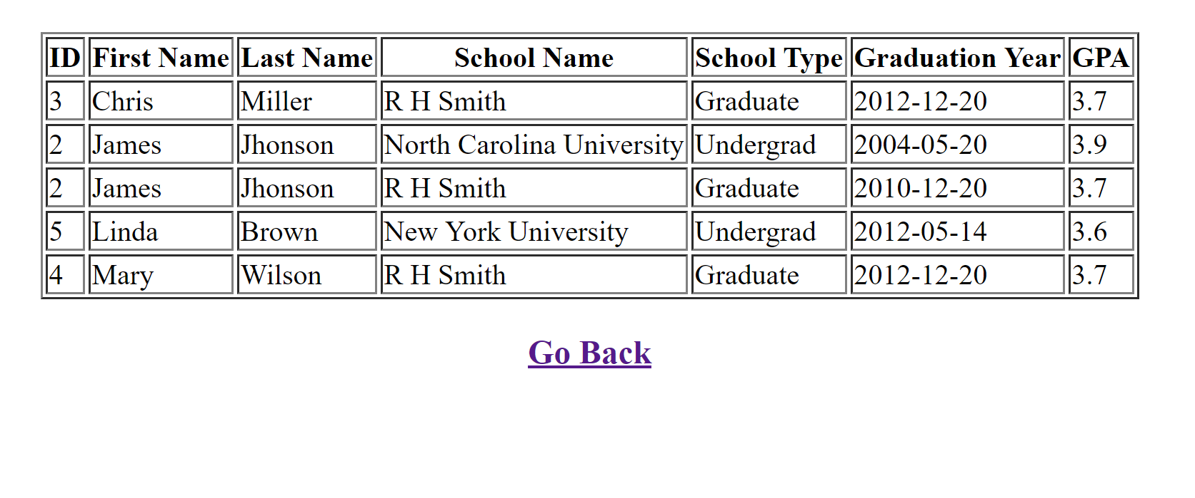
What alumni graduated before 2014 with a CGPA of above 3.5?
We joined the alumnus and education tables and have applied filters for graduation year and CGPA to get results about alumnus who graduated before 2014 and have a CGPA of above 3.5.
Five alumni match both constraints and can be viewed in the above table.

Slide 16

Thank You!

